Slide 1
Calvin Jones jones the numbers calvin@jtn.cymru
Measuring what you manage? Regional economic statistics, evidence-informed policy and multi-level governance in the UK

Slide 2

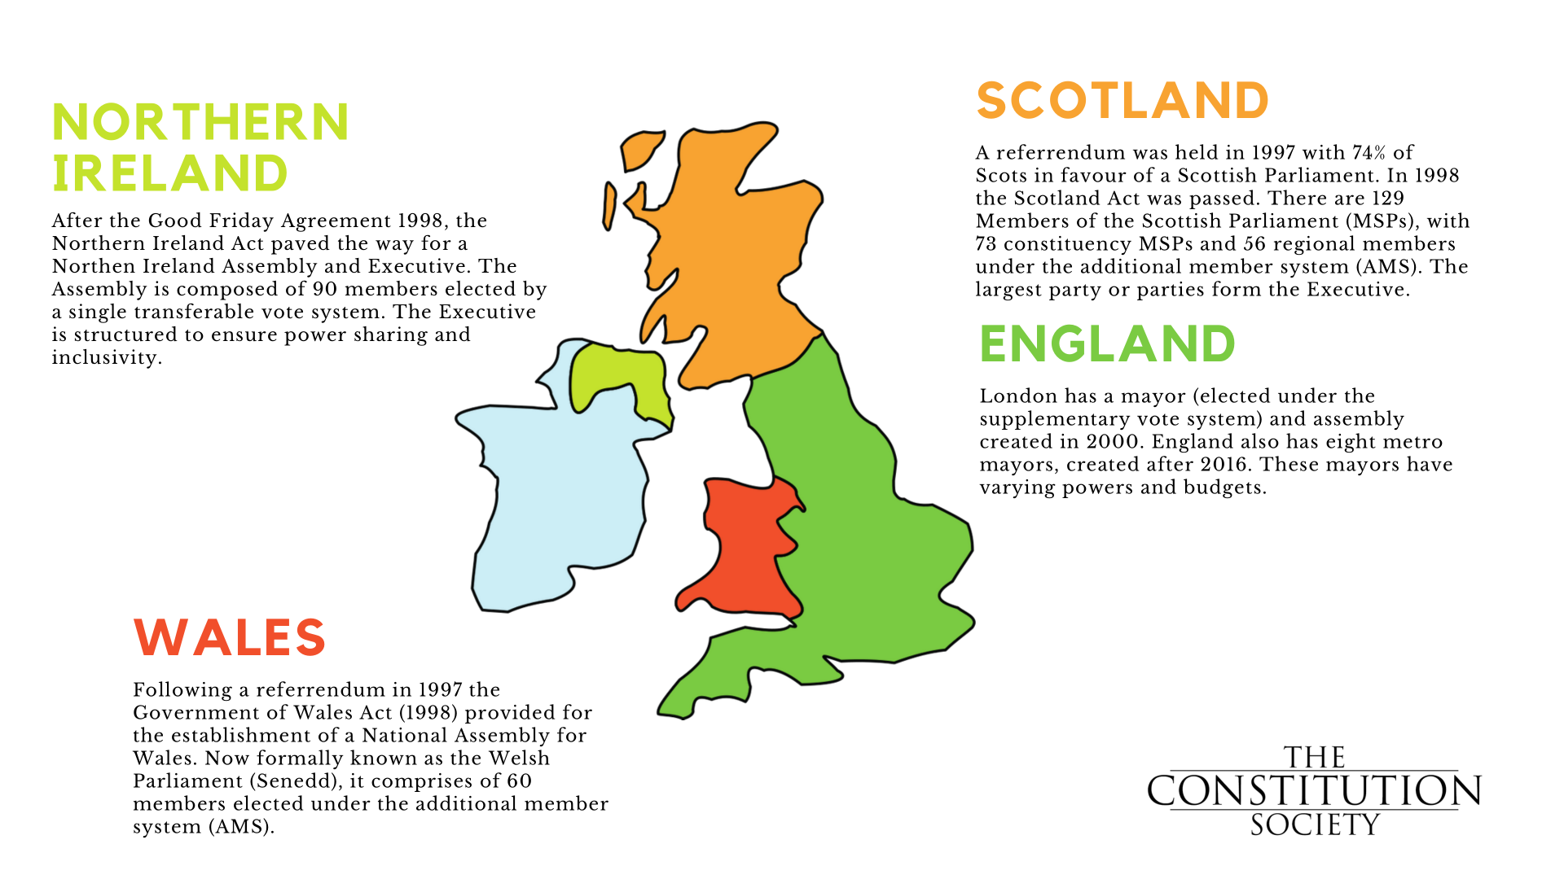
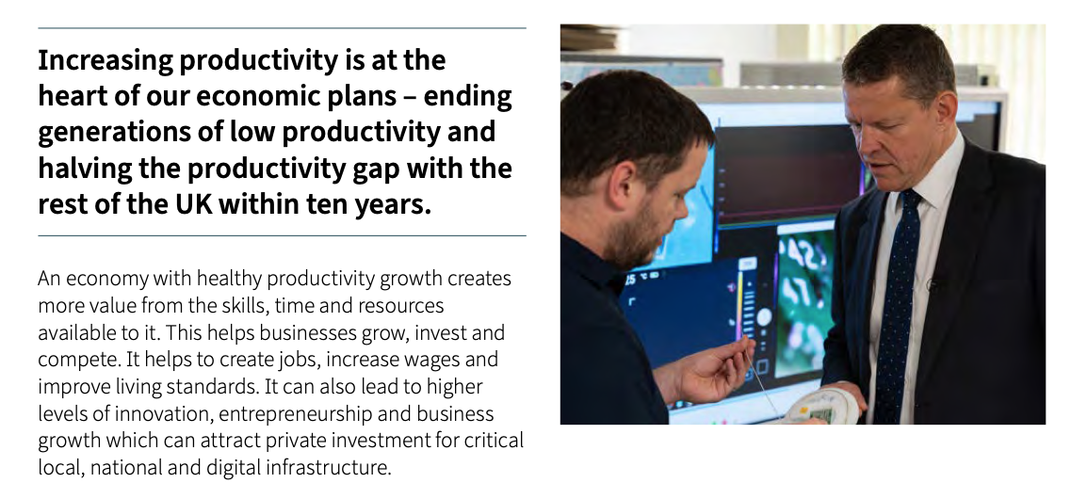
Motivation
Notes:
Post 1999 devolution for Celtic nations
Joined now by focus on English (metropolitan) devolution
Includes – very explicitly economic power (plus skills, transport)
Hence need for robust & extensive economic intelligence to manage regional economies

Slide 3

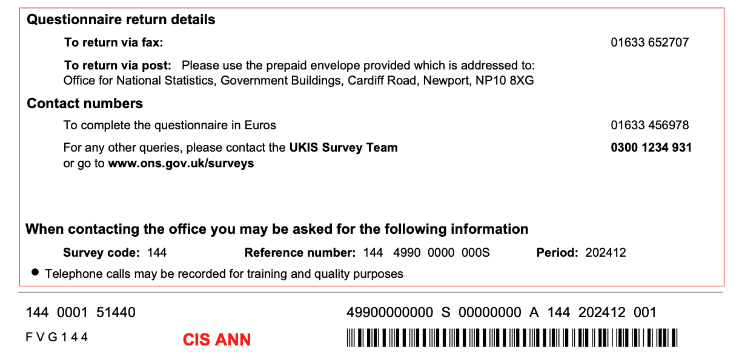
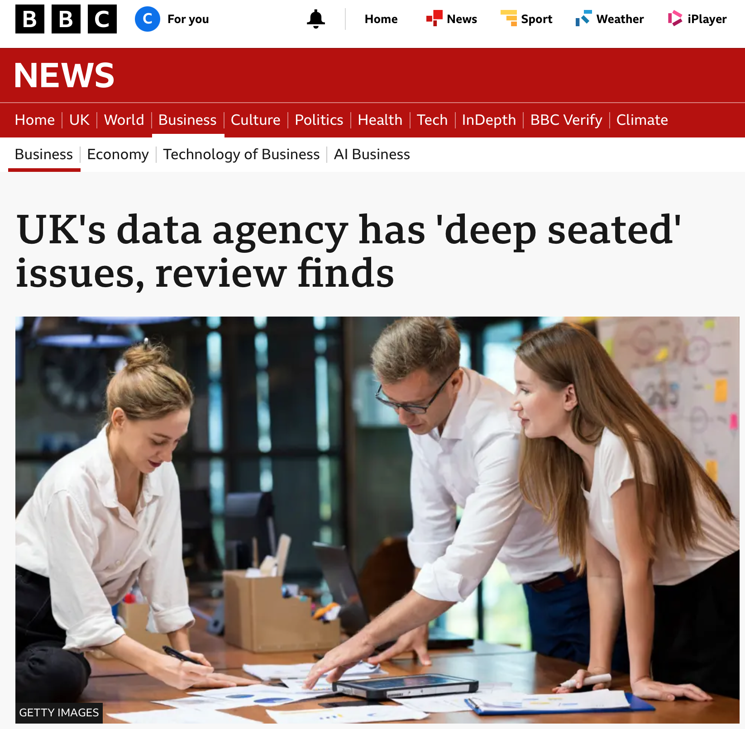
Notes:
This devolution is piecemeal: Westminster retains sovereignty & it progresses via a series of messy Bills and Acts. This is NOT federalism…
Frictions about – typically over finance & fiscal transfers, devolution of further power and squabbling over central government encroachment in devolved areas for political reasons.
Less addressed is the question of how far underpinning governance infrastructures – including stats – are fit for devolution purpose. But this really matters

Slide 4
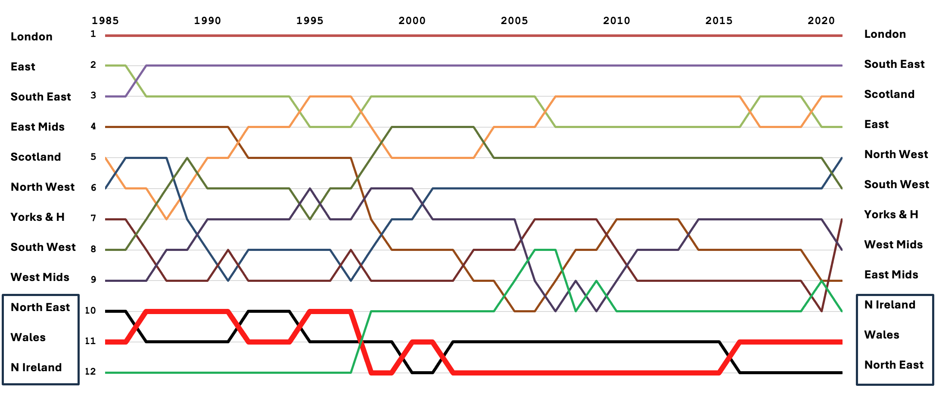
GVA per capita, UK Regions 1985 - 2021
Notes:
This matters because the UK is one of the most regionally unequal European countries, and has been for decades. Levels of GVA per capita have exploded in London and the greater SE and that region has pulled away from slower growing North and West. Moreover, the three lagging regions have remained at the bottom for 40 years, probably 400. Rhe situation is neither economically efficient or politically palatable (see Brexit, Reform..)

Slide 5
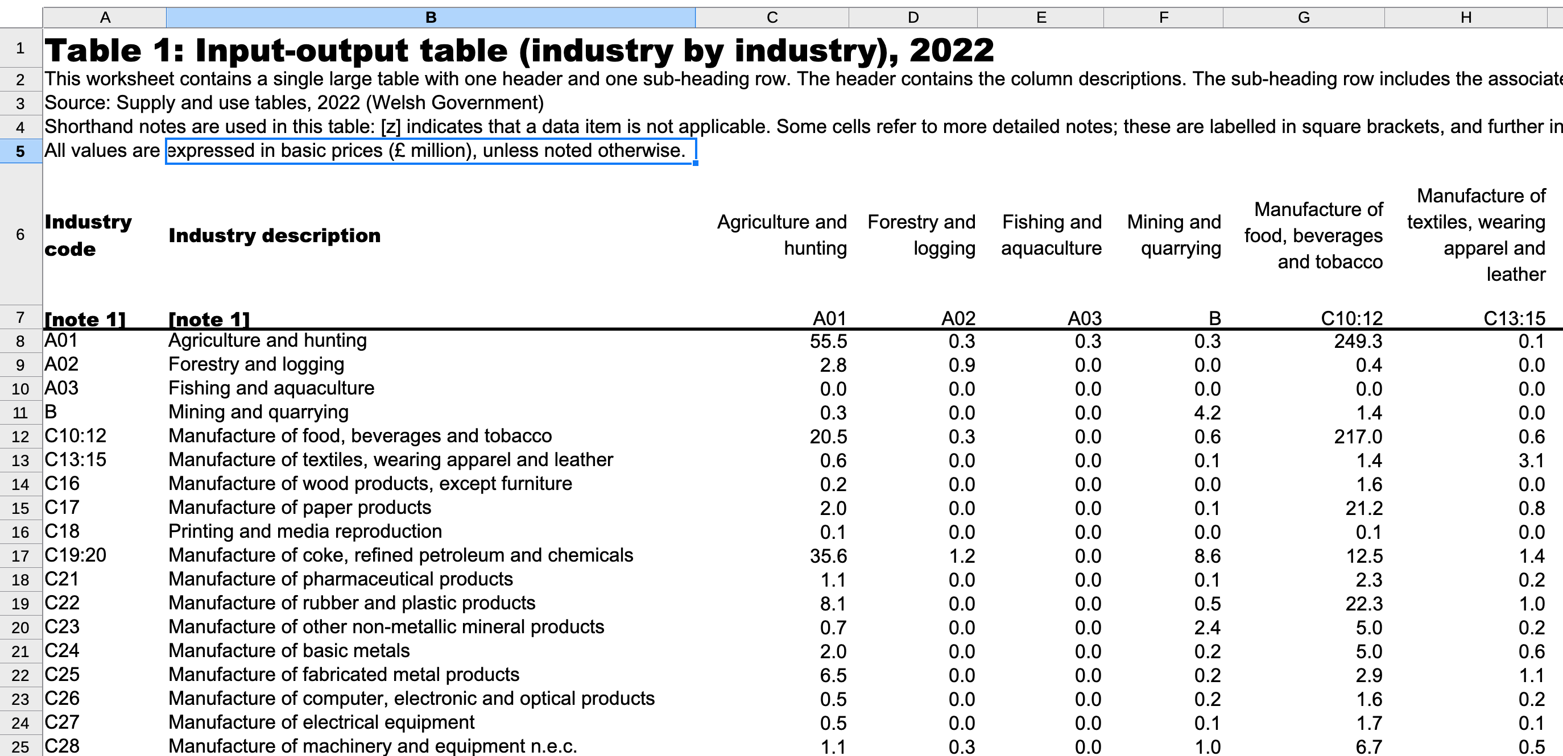
The Input-Output Tables for Wales
Lack of formal regional accounting undertaken by UK government
‘Fill in’ by regional government agencies – Input-Output Tables – in Scotland (since 1995) and Northern Ireland (2015) plus ad hoc academic studies
Wales joined in 2019 (and now 2022) with Supply & Use and Input-Output Tables
Tourism Satellite Account in development
https://www.gov.wales/supply-and-use-tables-and-input-output-tables-2022
Notes:
IOTs developed to fill clear policy gap
Required collation & reconciliation of dozens of data sources, both survey and administrative
Excellent opportunity to assess quality, timeliness, scope & robustness of sub-national economic statistical landscape/

Slide 6

Where is regional economic data?
No relevant ONS surveys are stratified and weighted at regional (NUTS1/ITL1) scale across the UK.
Companies’ House data only identify in which region a firm is HQ’d, not where capital/employees are deployed or profits made.
HMRC trade data allocate trade estimates (volumes/destinations) based on regional firm employee share.
The main household consumption survey has an annual sample size of a few hundred households per UK region (!)
Global issues of declining survey response rates have order-of-magnitude greater impacts at regional scale

Slide 7
Where is UK regional economic data going?
Plan for improvement of Economic Statistics but likely to be a drawn out and difficult process: e.g. transformation of the Labour Force Survey (TLFS) already delayed;
Transformation of Annual Business Survey, improvements/ modernization of systems
Focus on national data (e.g. see re-estimation of ‘Productivity Puzzle’ data mean subnational issues will see co-benefits rather than direct attention
Some significant improvements – e.g., use of Real Time Information on pay-as-you-earn, Business to Business transactions data, regional (or at lease Wales) stratification of ABS…
New Chief Statistician for UK from federal, bilingual Canada(!)

Slide 8
Where are UK regions going?
However... ONS is fundamentally born of a unitary state – where the only economic governance that mattered came from Westminster, HM Treasury and Threadneedle Street,
Underfunding of Economic Statistics for decades will not be easily reversed, especially in a State that generally finds investment difficult,
Increasing economic autonomy in Celtic countries and English Metro regions will require sophisticated nuanced – and potentially bottom up – intelligence that ONS was never structured to deliver
The (policy off) prospect is for increasing fragmentation, inefficiency & lack of comparability as regional actors turn to private consultants & proprietary modelling to fill gaps in data & analysis to let them do their job.

Slide 9
Calvin Jones jones the numbers calvin@jtn.cymru
Measuring what you manage? Regional economic statistics, evidence-informed policy and multi-level governance in the UK
Diolch am wrando / Thanks for listening

